Slide 1
Feline Type 2 Diabetes
Optimal Nutrition for Domestic Cats
Presented By Robb Keele

Slide 2
Type 2 Feline Diabetes
Accounts for 90% of all cases of feline diabetes.
(Gottlieb & Rand, 2018)

Slide 3
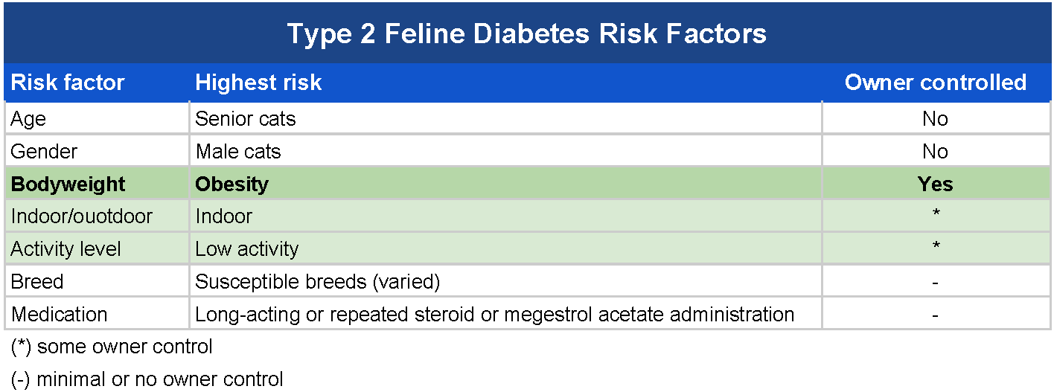
Risk Factors
Source Adapted from (Gottlieb & Rand 2018, Diabetes in cats ).

Slide 4
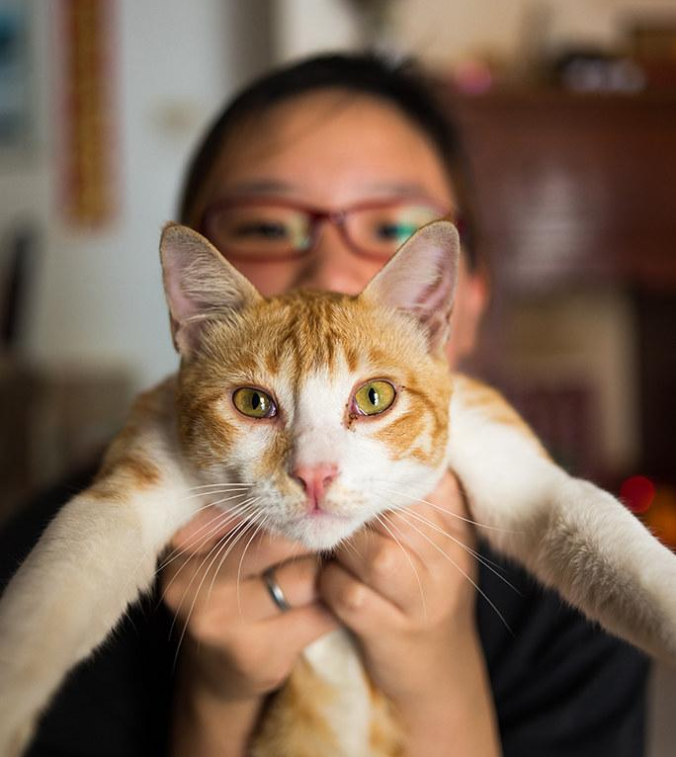
Overweight cats are 4-6 times more likely to develop type 2 diabetes than their ideal body weight counterparts.

Slide 5
Ideal Caloric Composition
Cats are obligate carnivores and require a diet composed of approximately:
50% protein
20% - 40% fat,
1% - 2% carbohydrates
From Pierson (2016)

Slide 6
Wet Food vs Dry Food
Cat food should have a moisture content of approximately 70%
Kibble (or dry food) has very little moisture content, and has a very high carbohydrate content
A diet consisting entirely of wet food is recommended for optimal nutrition and maintaining a healthy body weight
From Pierson (2016)

Slide 7
A Few Recommendations
Fancy Feast Natural (All varieties)
Natural Balance Delectable Delights - LID Tuna & Pumpkin cups
Pro-Plan Focus - Kitten Salmon & Oceanfish
Royal Canin Calorie Control - Pate
Meow Mix Tender Favorites in Sauce - Tuna & Shrimp
Look for foods that are high in protein (>50%), moderate fat (20% - 40%), and with less than 10% carbohydrate caloric content. (Pierson, 2017)

Slide 8
Refrences
Gottlieb, S., Rand, J. (2018). Managing Feline Diabetes: Current Perspectives .Retrieved from https://www.ncbi.nlm.nih.gov/pmc/articles/PMC6053045/
Pierson, L.A. (2016). Feline Diabetes. Retrieved from https://catinfo.org/feline-diabetes/
Pierson, L.A. (2017). Cat Food - Nutritional Composition . Retrieved from https://catinfo.org/docs/CatFoodProteinFatCarbPhosphorusChart.pdf

